Slide 1

GAMING ARTICLE WEBSITE
Presented By Group 3
Fikhri Maheswara Taswandi
Layalia Hasya

Slide 2
System Summary
The gaming article webstie are build using laravel as our script language that makes us easier to build the website faster, write a cleaner code, build a secure application, and develop robust application.
Laravel is a web framework that streamlines development by providing pre-built solutions, promoting code organization, enhancing security, and enabling the creation of scalable and maintainable web applications.

Slide 3
Table Contain :
There are 4 table contain, which is :
- Users
- Authorrequest
- Article
- Categories

Slide 4
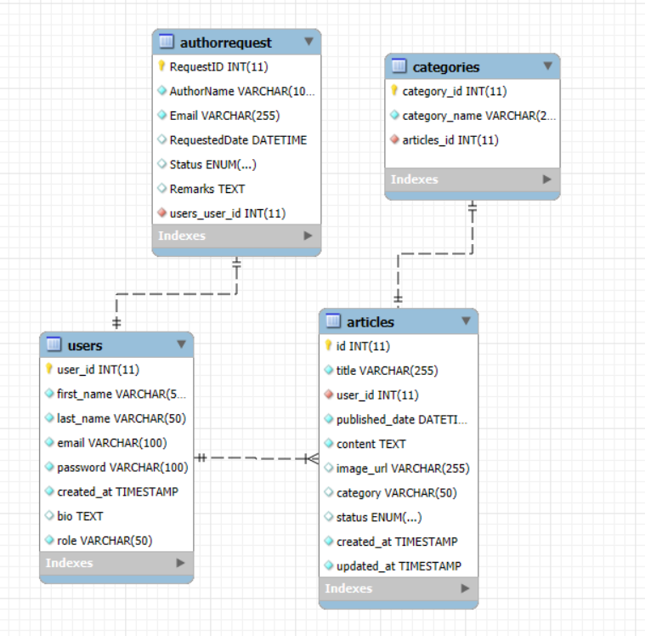
SCHEMATIC DIAGRAM

Slide 5
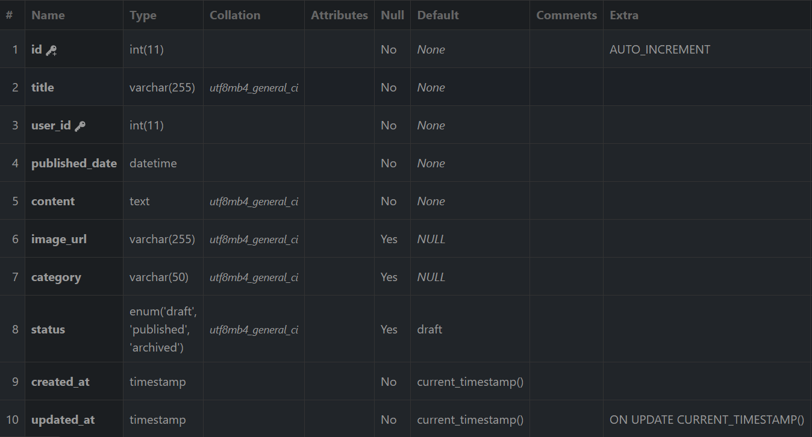
Table
users table

Slide 6
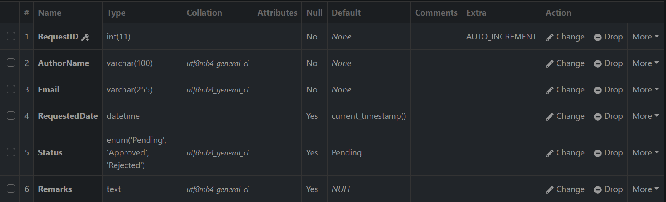
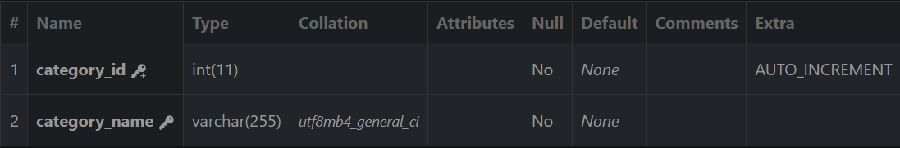
Table
Authorrequest
categories table

Slide 7
Table
articletags table

Slide 8
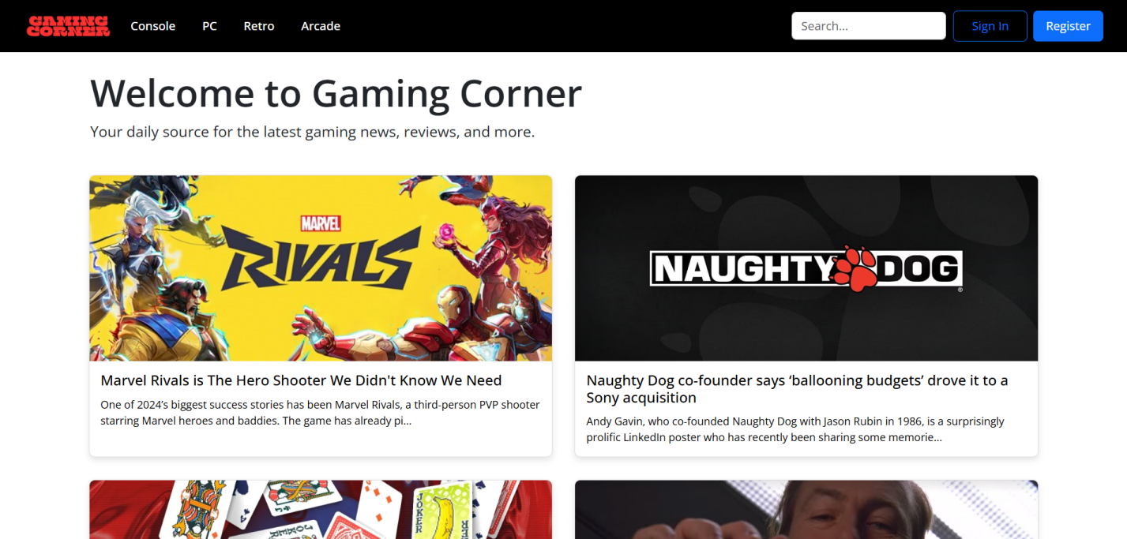
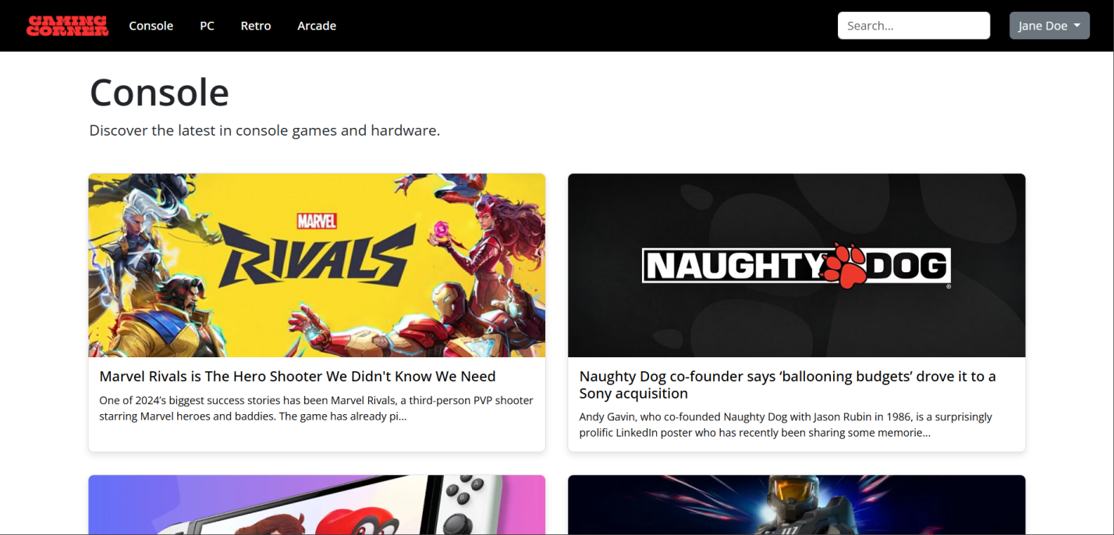
PREVIEW OF WEBSITE
home page
category page

Slide 9
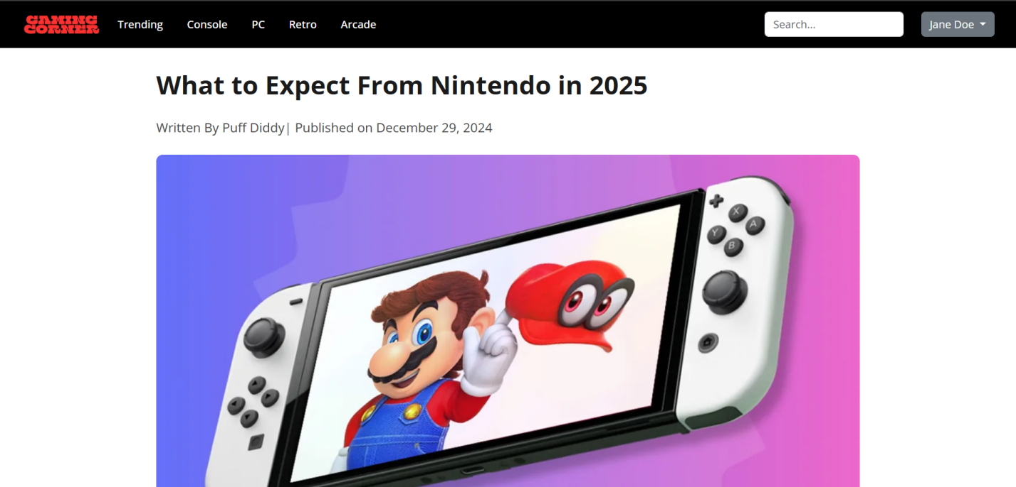
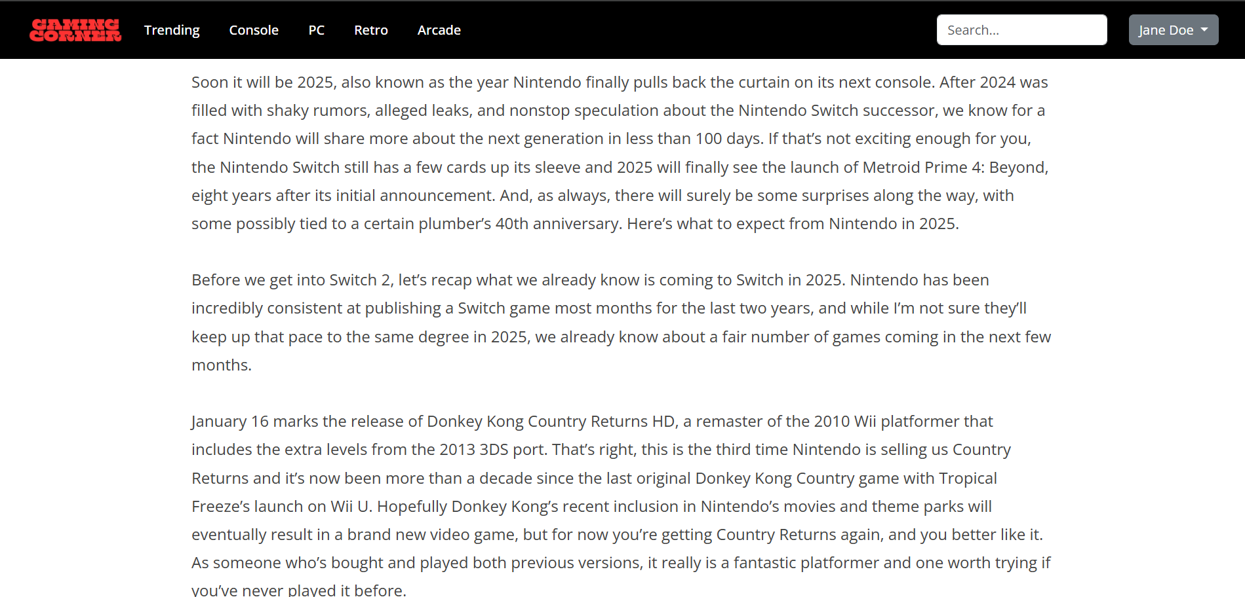
PREVIEW OF WEBSITE
Article content
article content (2)

Slide 10
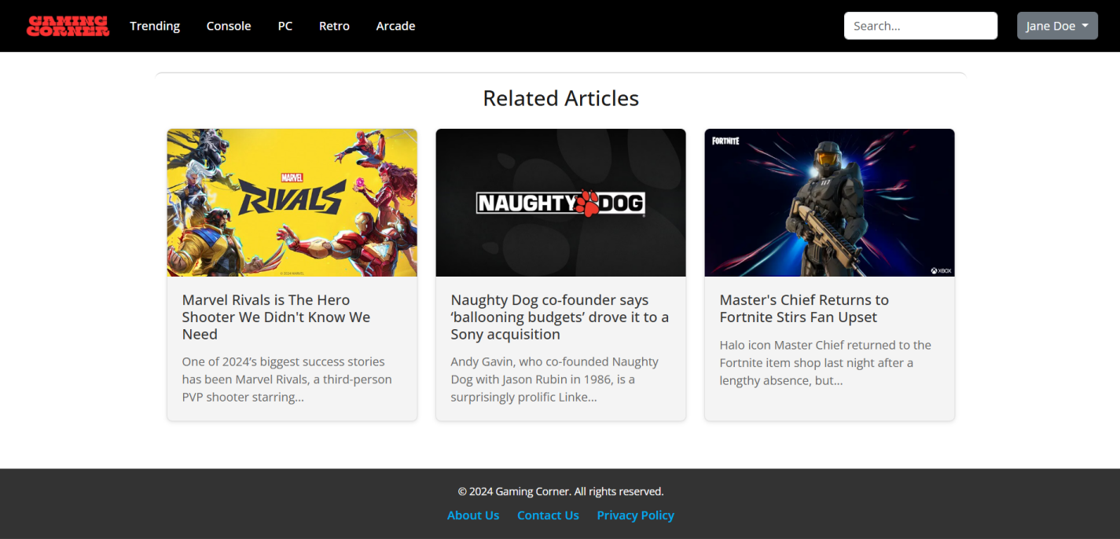
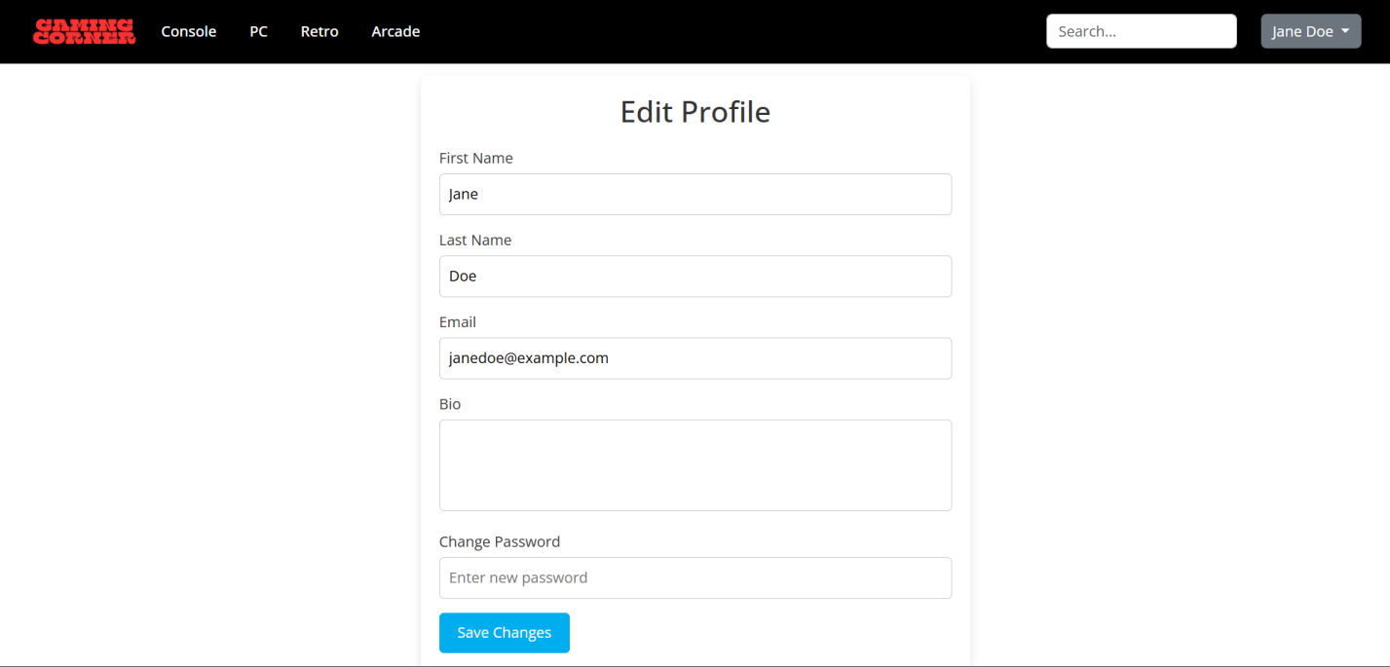
PREVIEW OF WEBSITE
Related to article content
profile page

Slide 11
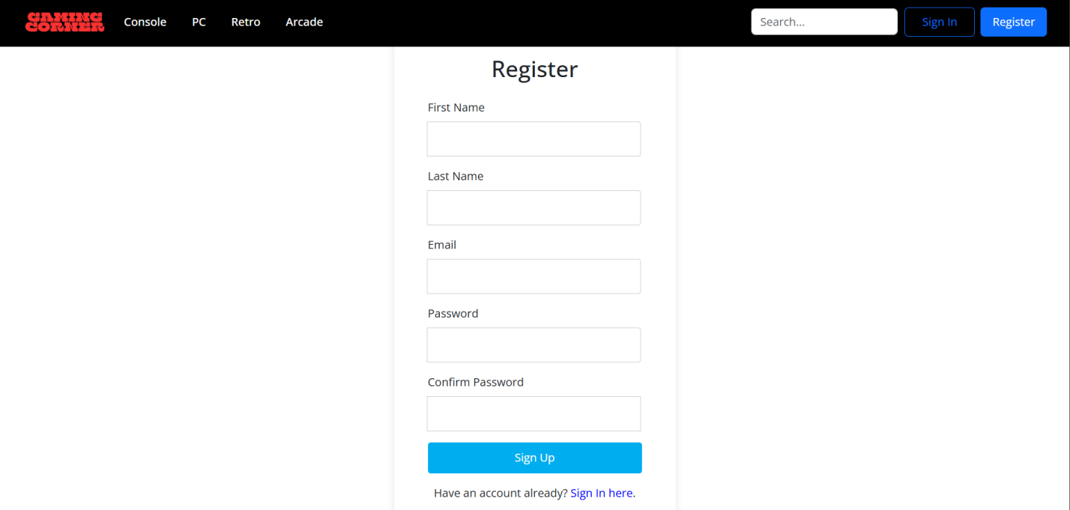
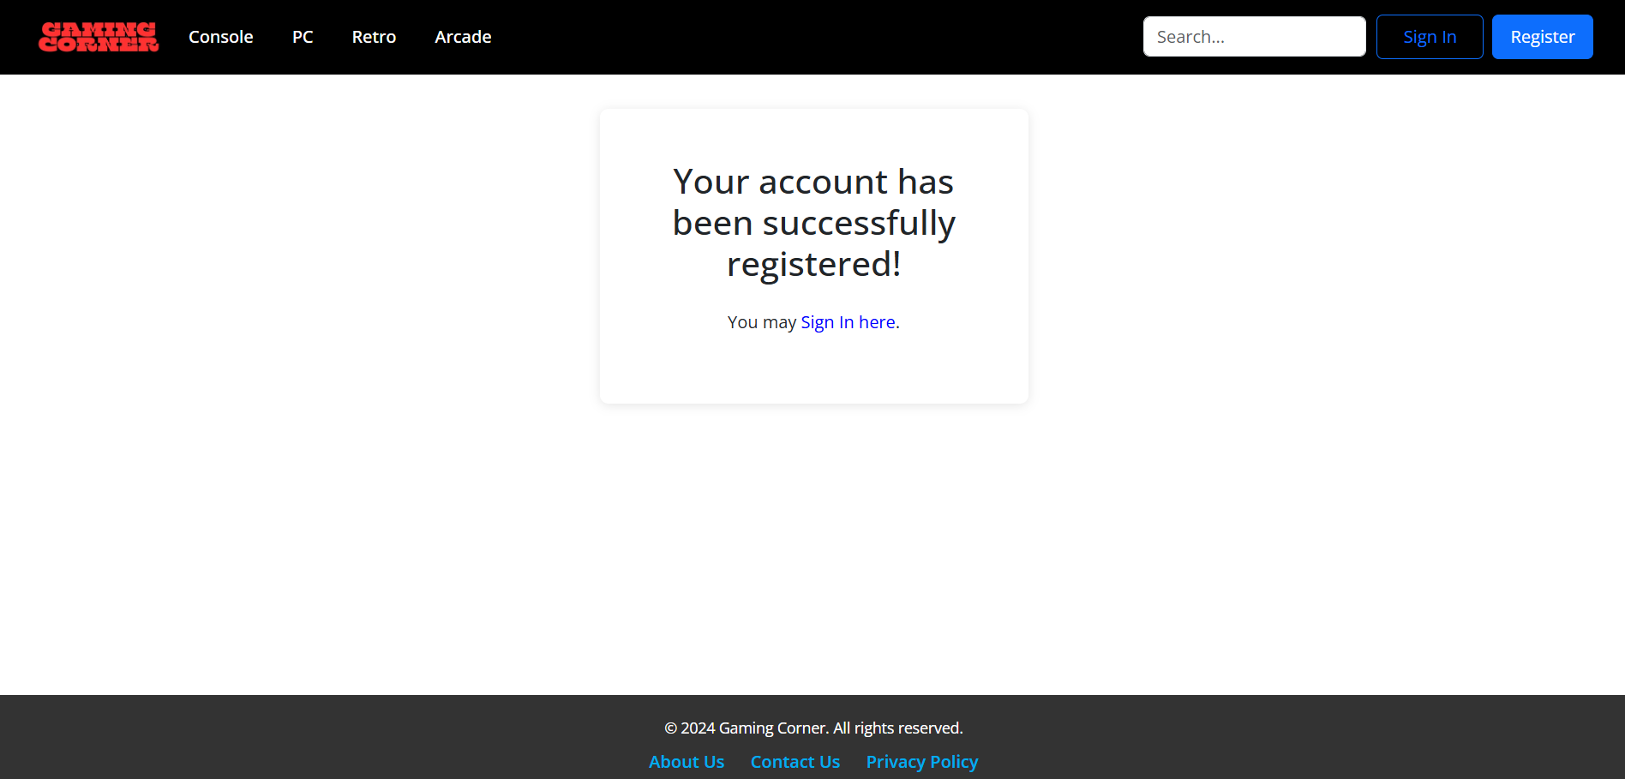
PREVIEW OF WEBSITE
Register page
after register

Slide 12
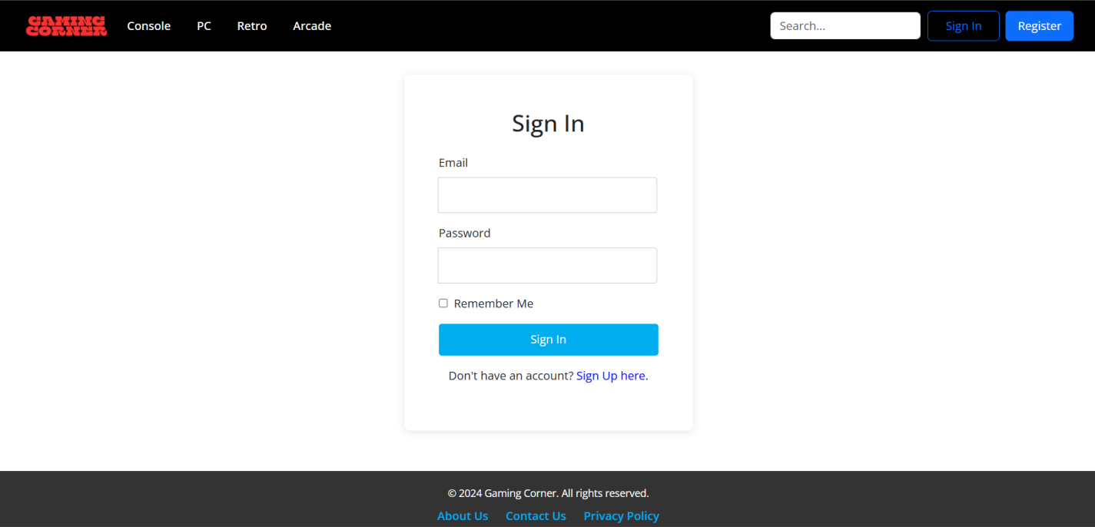
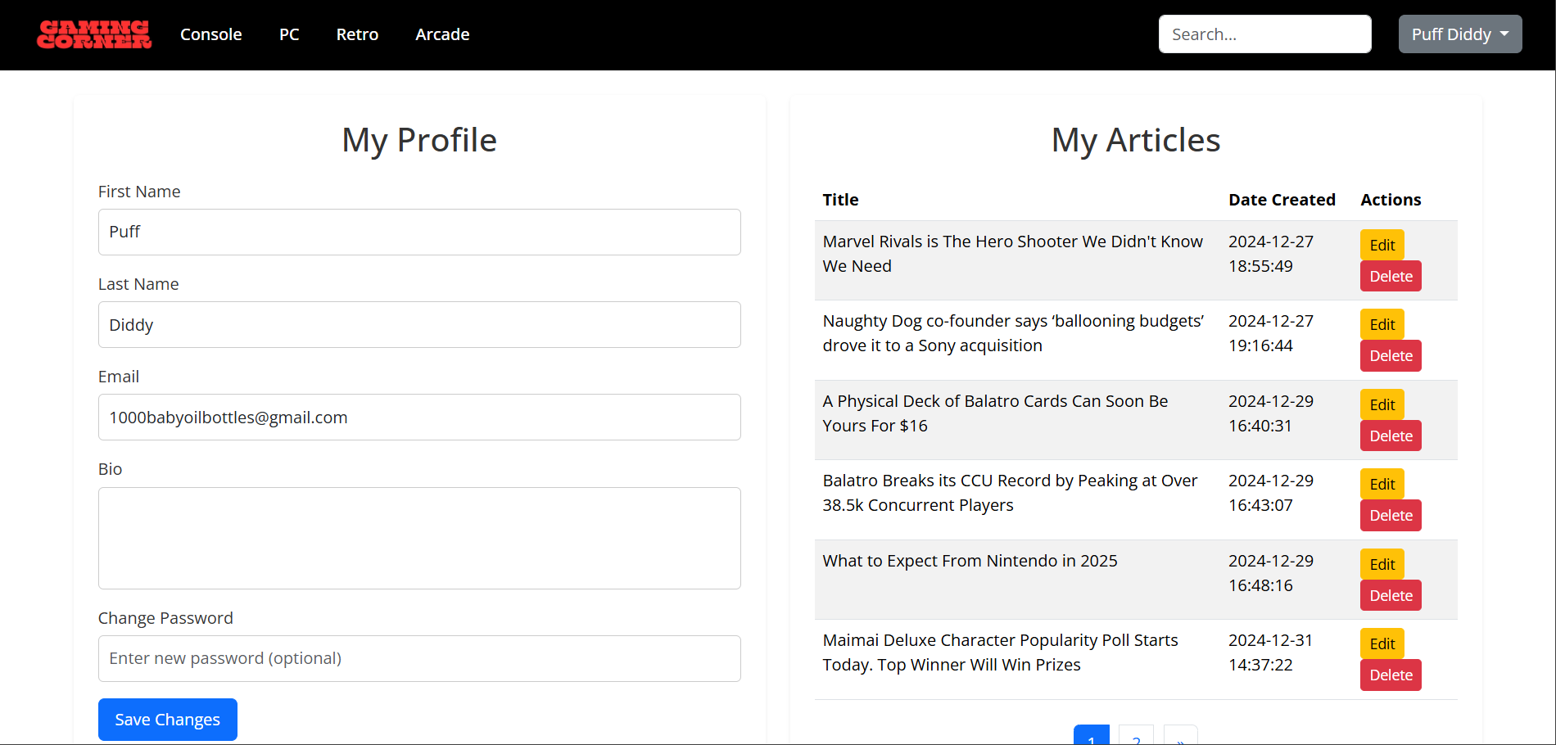
PREVIEW OF WEBSITE
sign in page
profile who write in the article

Slide 13
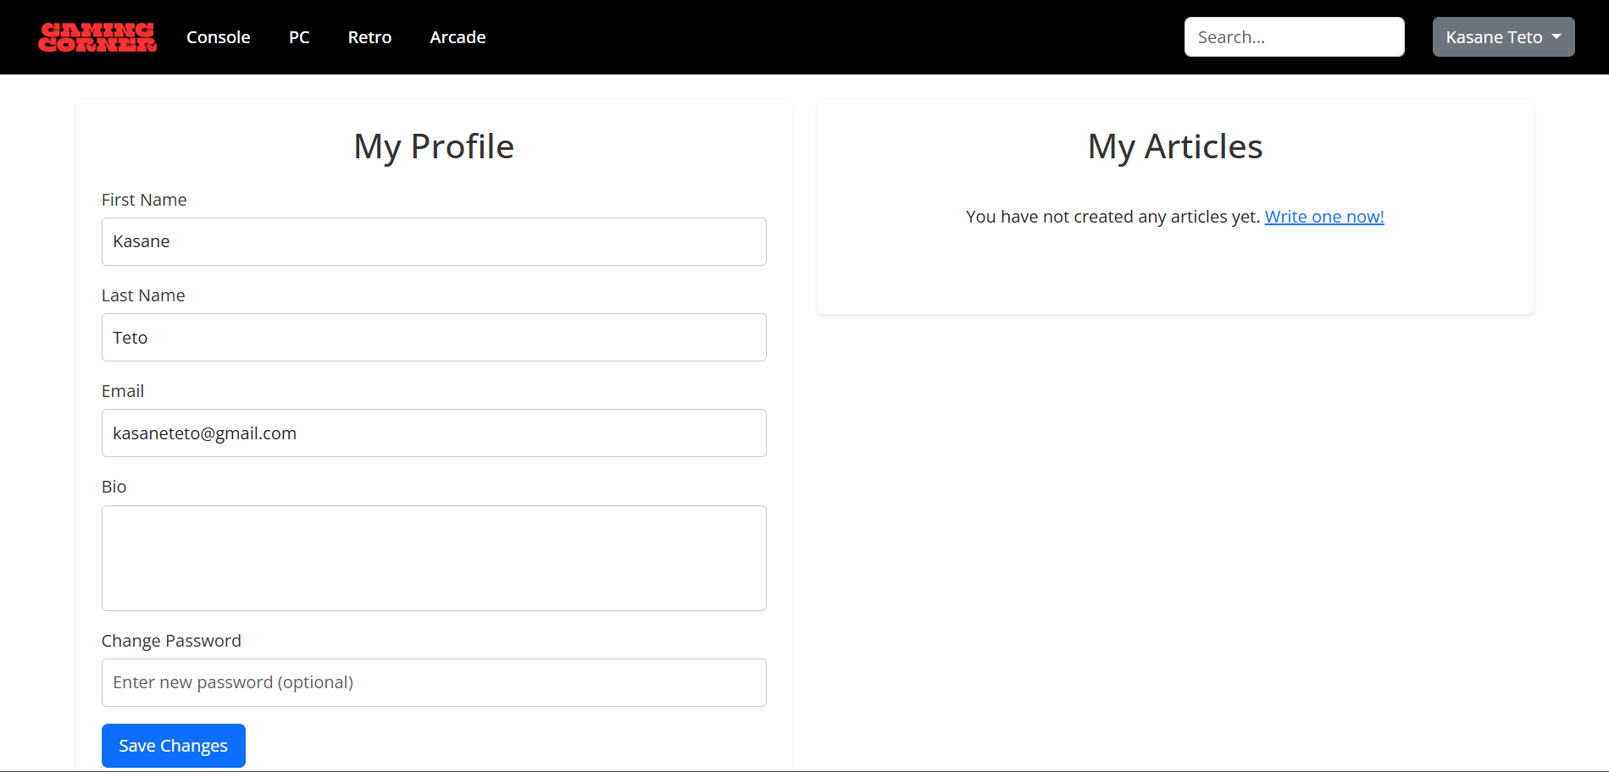
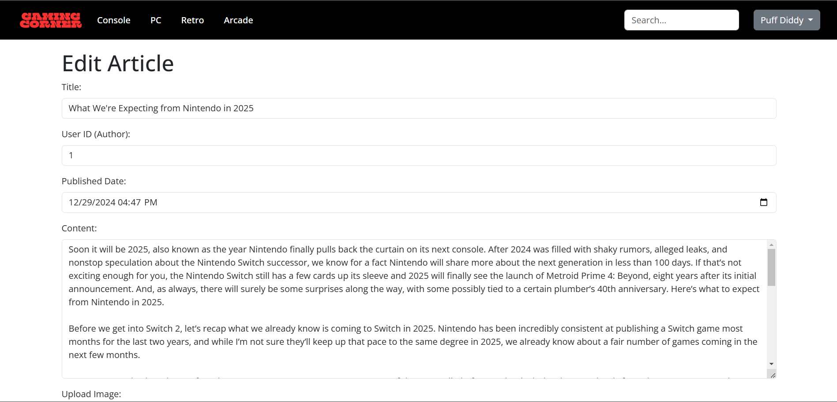
PREVIEW OF ARTICLE
profile who hasn’t write any article
When editing article

Slide 14
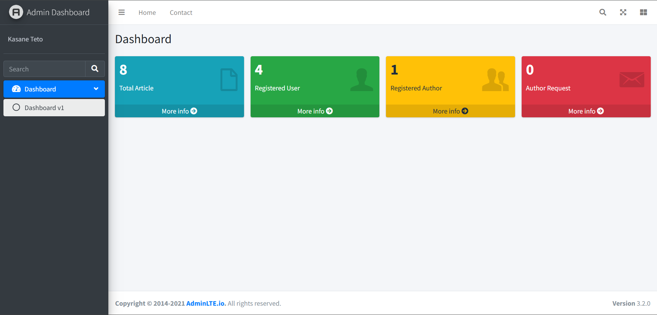
PAGE UI ADMIN

Slide 15
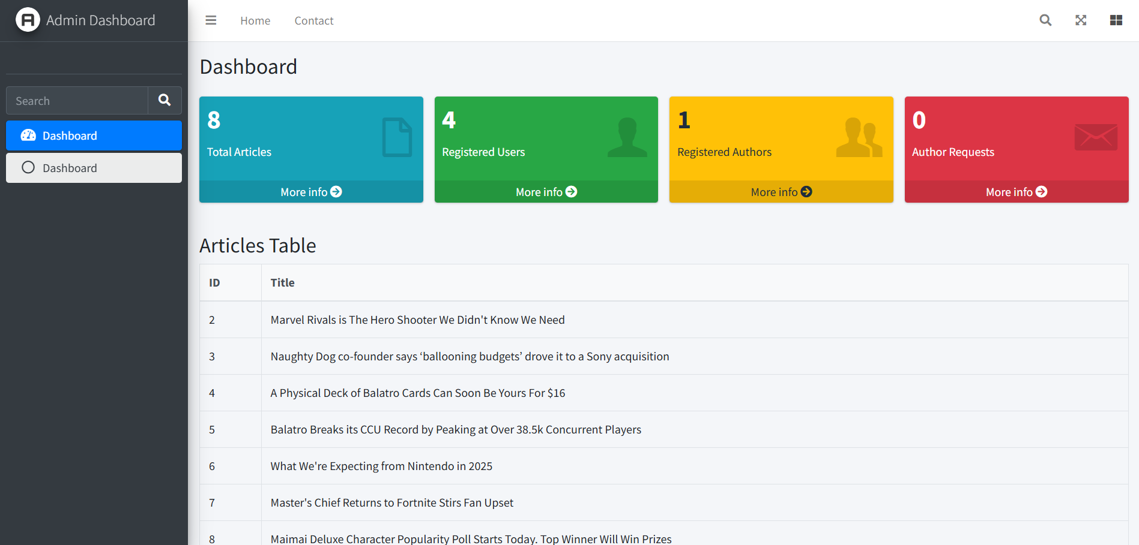
TOTAL ARTICLE

Slide 16
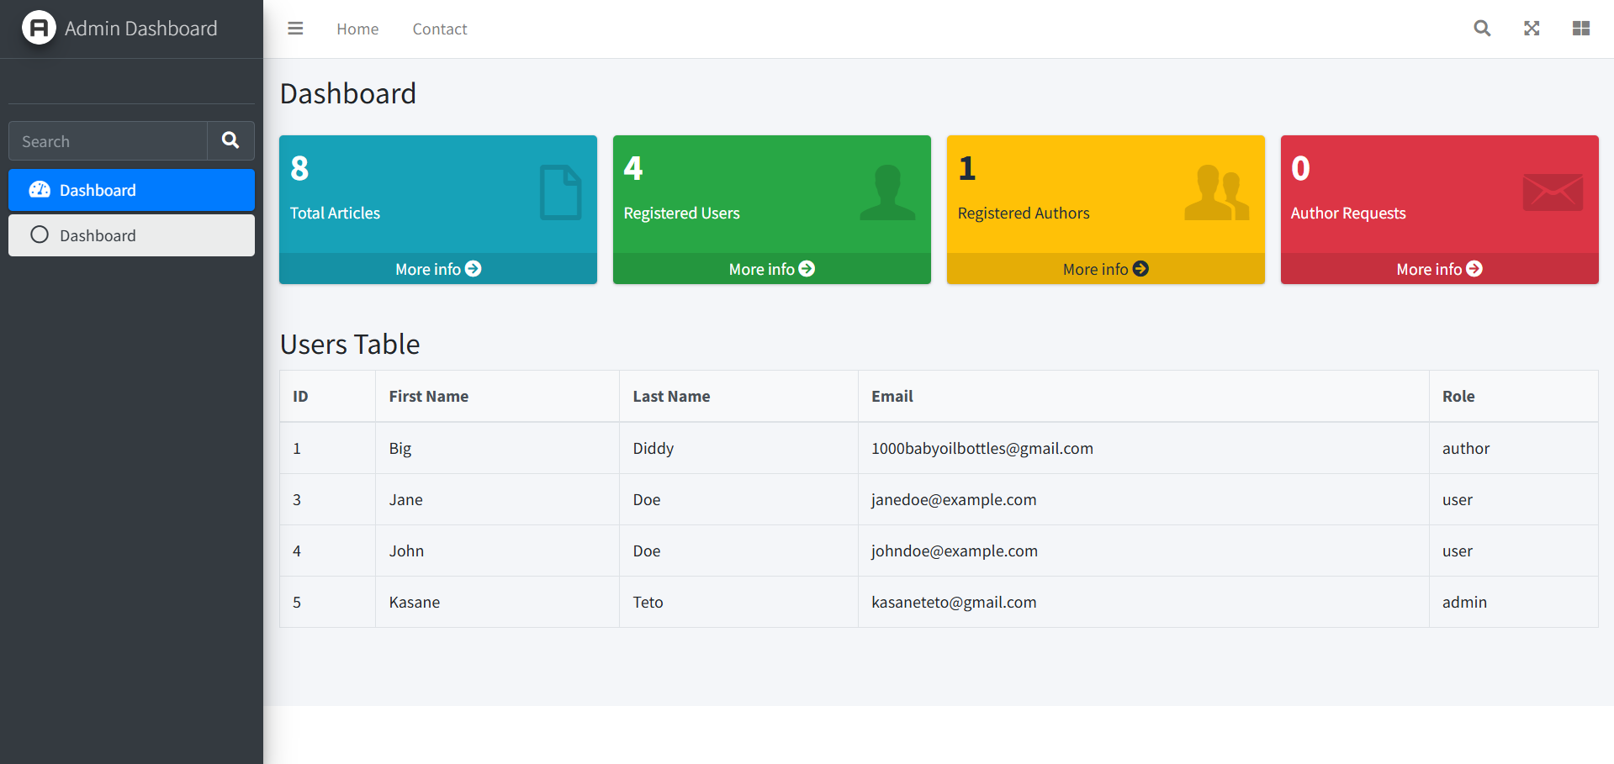
REGISTERED USERS

Slide 17
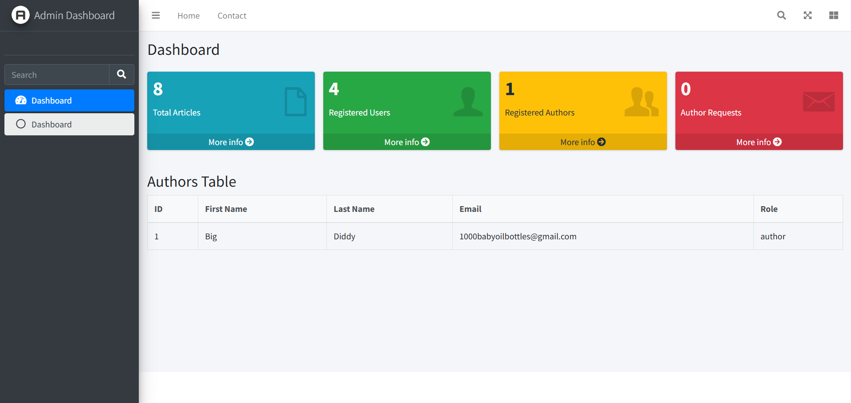
REGISTERED AUTHORS

Slide 18

AUTHOR REQUESTS

Slide 19
Thank you
You may ask any question about this presentation!

